Slide 1

Arduino
Module
Rohit Kumar

Slide 2
Contents
Title | Page
Arduino Uno Hardware
Arduino Hardware
Arduino Software

Slide 3
Technical Specifications
Microcontroller | ATmega328
Operating Voltage | 5V
Digital I/O Pins | 14 (of which 6 provide PWM output)
Analog Input Pins | 6
DC Current per I/O Pin | 40 mA
DC Current for 3.3V Pin | 50 mA
Flash Memory | 32 KB of which 0.5 KB used by bootloader
SRAM | 2 KB
EEPROM | 1 KB
Clock Speed | 16 MHz

Slide 4
Arduino
Hardware
1. Power USB
2. Power (Barrel Jack)
3. Voltage Regulator
4. Crystal Oscillator
5,17. Arduino Reset
6. Supply 3.3 output volt
7. Supply 5 output volt
8. Ground
9. Vin
10. Analog pins
11. Main microcontroller
12. ICSP pin
13. Power LED indicator
14. TX and RX LEDs
15. Digital I / O
16. AREF

Slide 5
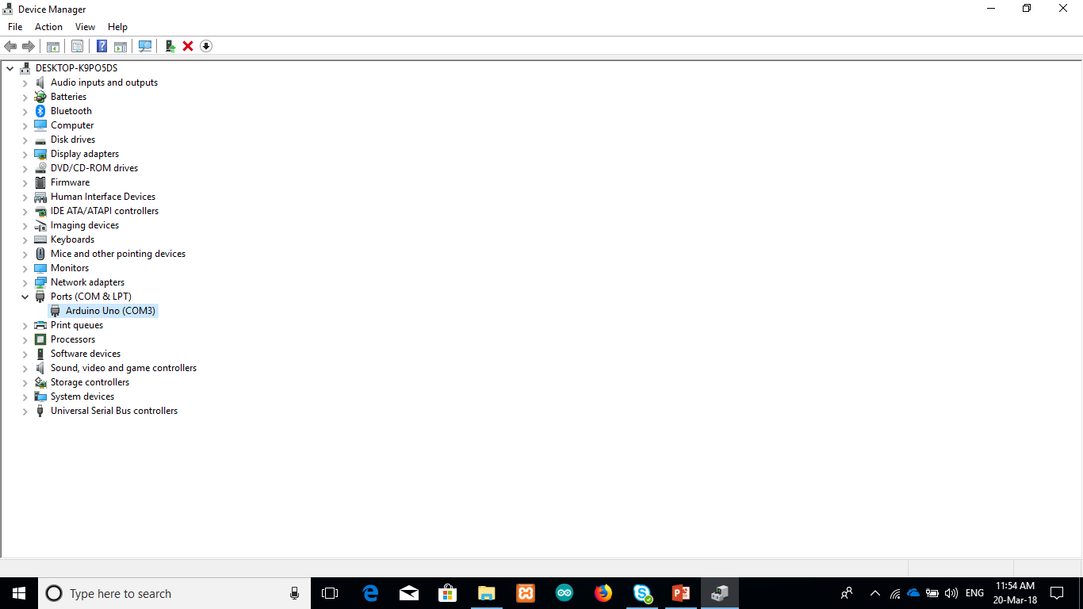
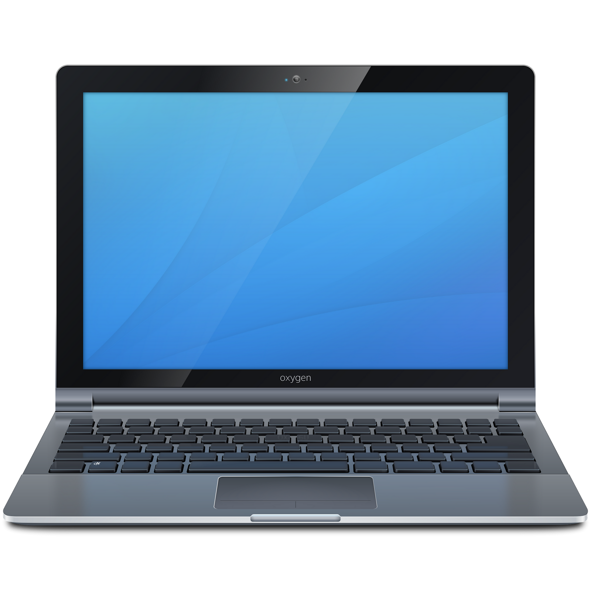

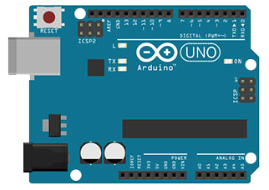
Connecting Arduino
Connect your Arduino to PC using usb
Recognize the port number in Device manager
Start programming Arduino Software

Slide 6


Soft Ware
Arduino Web Editor
Arduino IDE
https://create.Arduino.cc
https://www.Arduino.cc

Slide 7
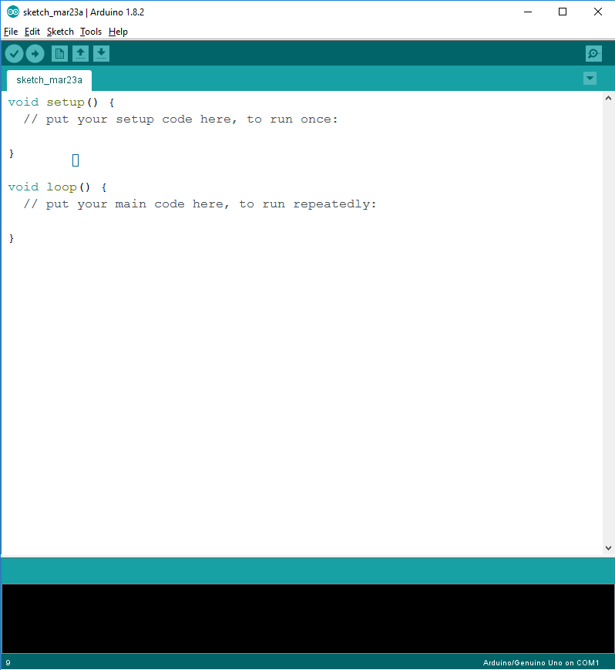
Soft Ware
1
6
Arduino IDE
5
Menu Bar
Text Editor
Debug Output Window
Connected Device Location
Project Title Tab
Button Bar
2
3
4

Slide 8
Function of each symbol appearing in the Arduino IDE toolbar.
A- Used to check if there is any compilation error.
B- Used to upload a program to the Arduino board.
C- Shortcut used to create a new sketch.
D- Used to directly open one of the example sketch.
E- Used to save your sketch.
F- Serial monitor used to receive serial data from the board and send the serial data to the board.

Slide 9
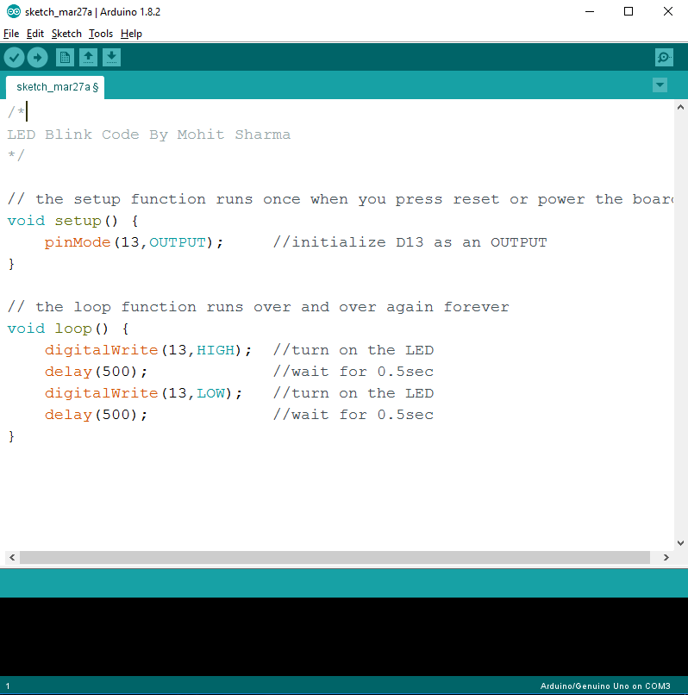
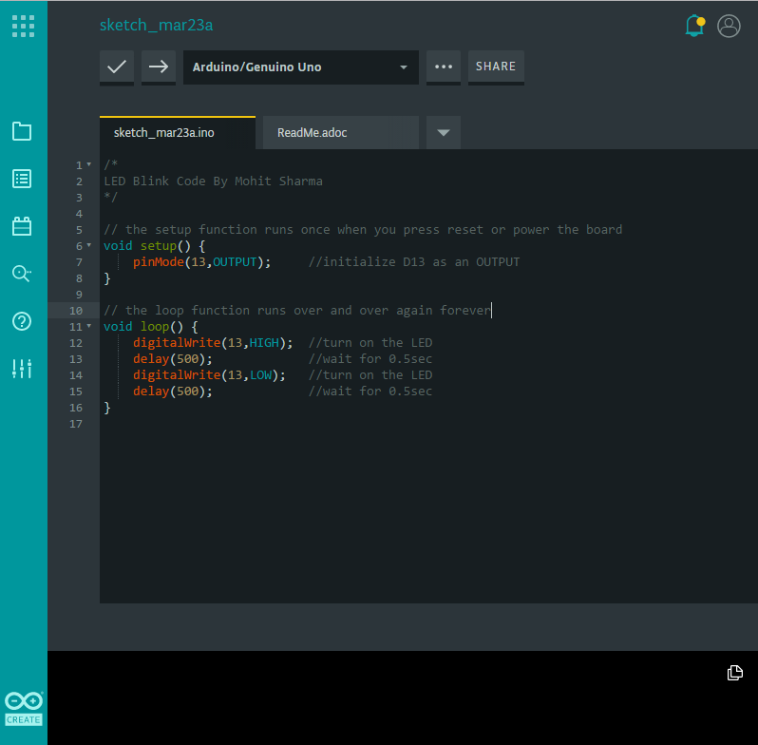
Hello World

Slide 10
Thank You !
Contact US
Nitin Sinha
nitin.sinha@goSigmaWay.com
+1 727-394-4375
+91 7838188809
Debjani Mitra
debjani.mitra@goSigmaWay.com
+1 952-583-3449
+91 9339555636
Rohit Kumar
rohit.kumar@sigmaway.us
+91 7982577830
+91 7838021754

